Slide 1
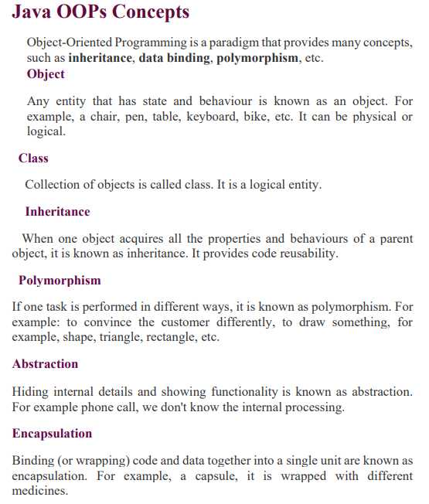

Slide 2
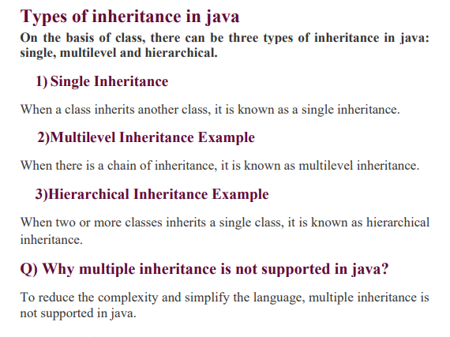

Slide 3
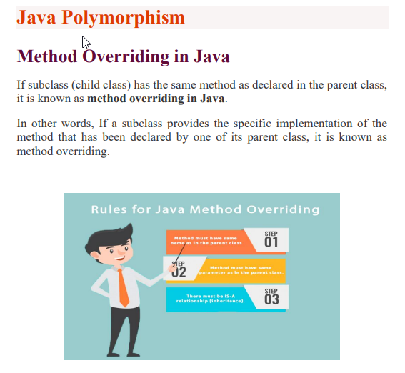

Slide 4
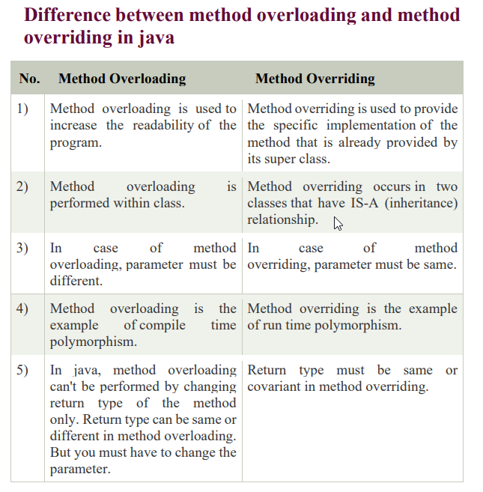

Slide 5
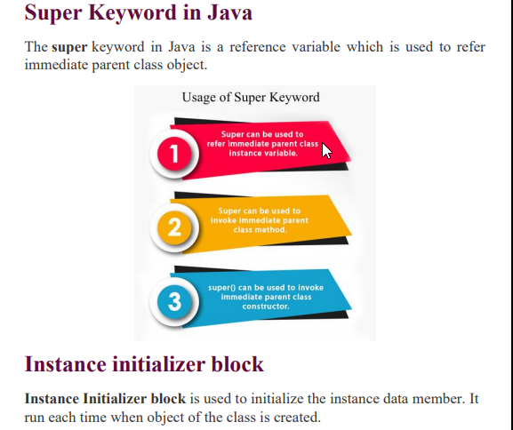

Slide 6
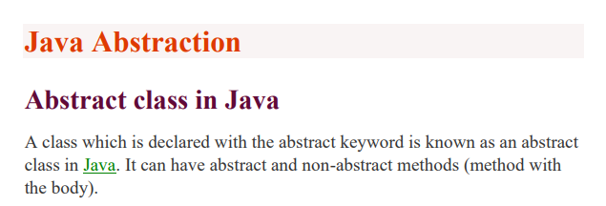
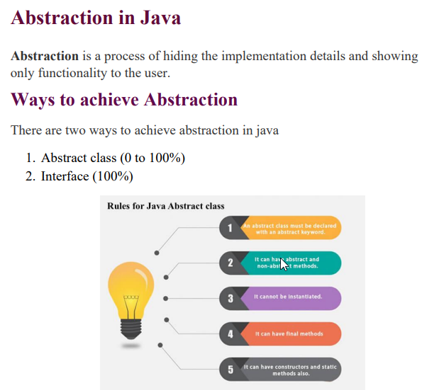

Slide 7
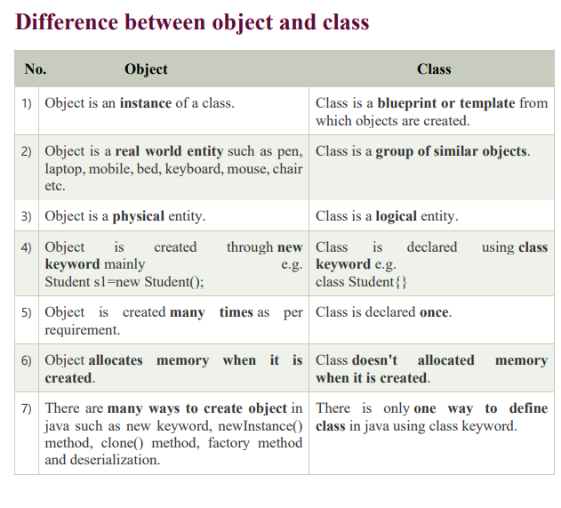

Slide 8
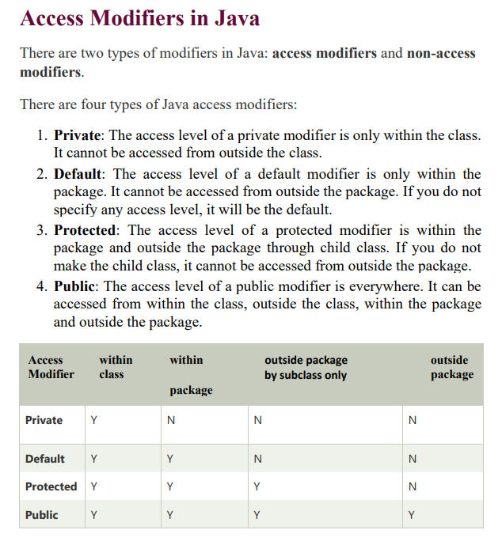

Slide 9
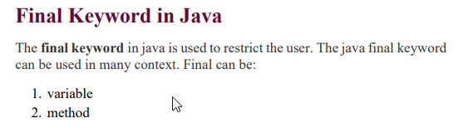
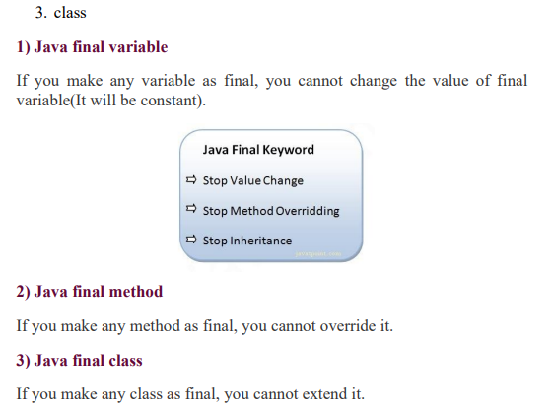

Slide 10
Final Example Program
public class FinalVariableExample {
public static void main(String[] args) {
final int PI = 3.14159; // Final variable
// Trying to change the value of PI (will result in a compiler error)
// PI = 3.14;
System.out.println("Value of PI: " + PI);
}
}

Slide 11
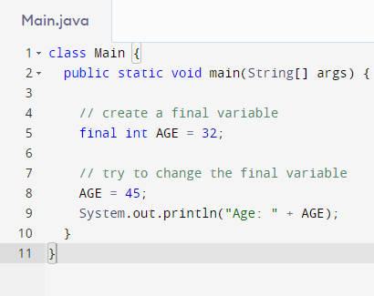
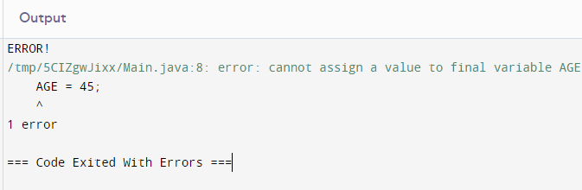

Slide 12
Final Method
class Parent {
public final void display() {
System.out.println("This is from the parent class");
}
}
class Child extends Parent {
// Trying to override the final method (will result in a compiler error)
// public void display() {
// System.out.println("This is from the child class");
// }
}

Slide 13
Final Class
final class FinalClass {
// Class body
}
// Trying to extend the FinalClass (will result in a compiler error)
// class DerivedClass extends FinalClass {
// }

Slide 14
Static in Java
A static keyword in Java is used to create members (variables, methods, blocks, or nested classes) that belong to the class itself rather than to instances of the class. This means you can access these members without creating an object of the class.
In simpler terms:
Static members are shared by all objects of a class.
They exist independently of any object.
You can access them directly using the class name.

Slide 15
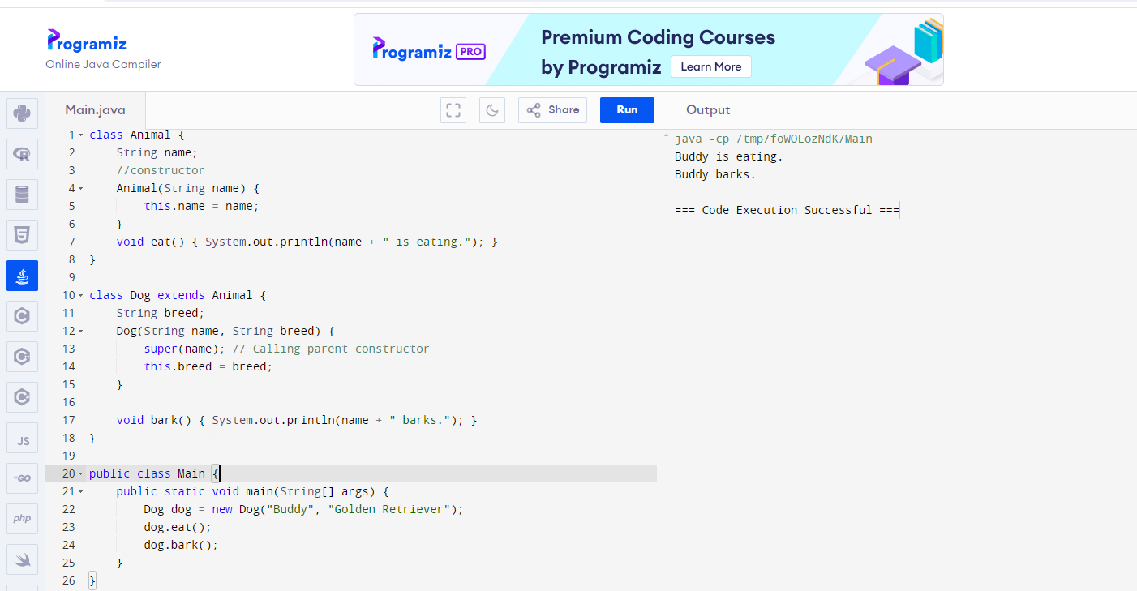

Slide 16
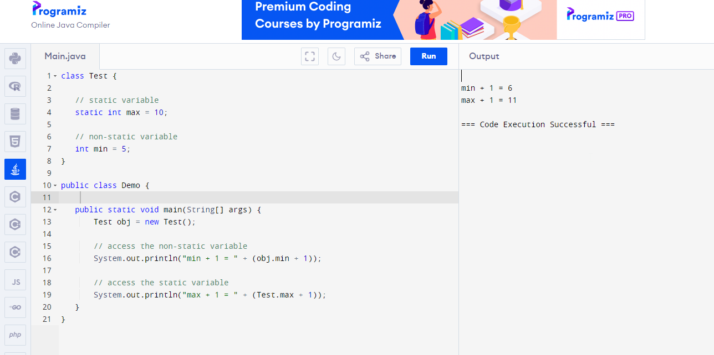

Slide 17
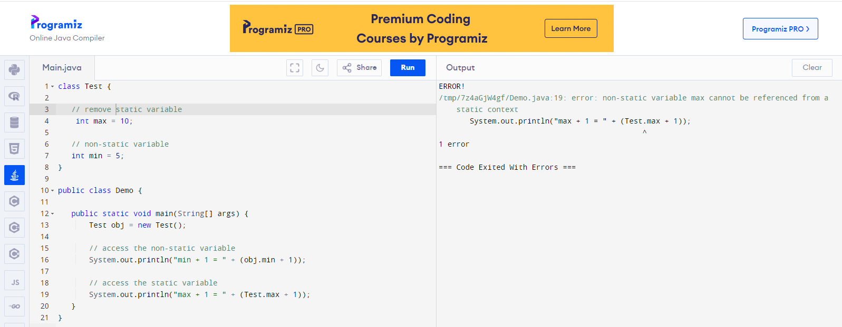

Slide 18
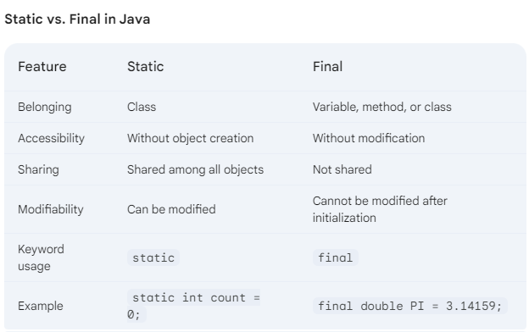

Slide 19
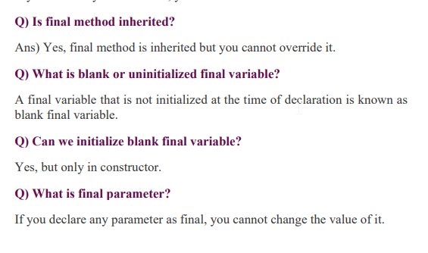


Slide 20
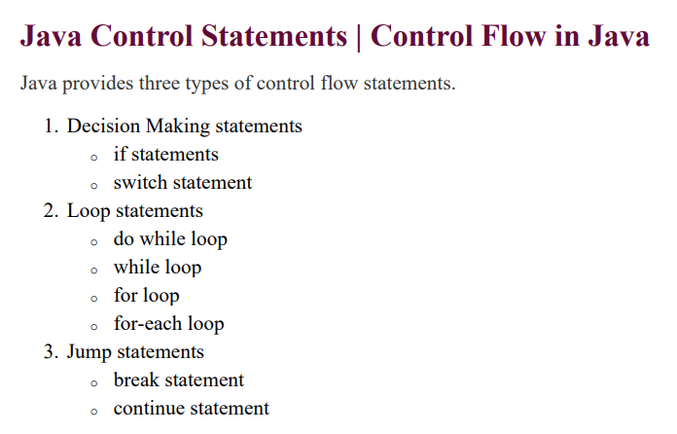

Slide 21
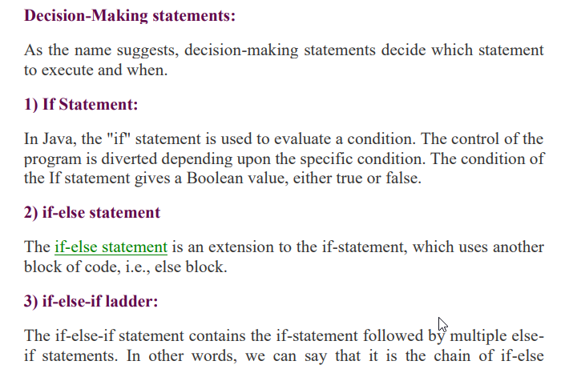
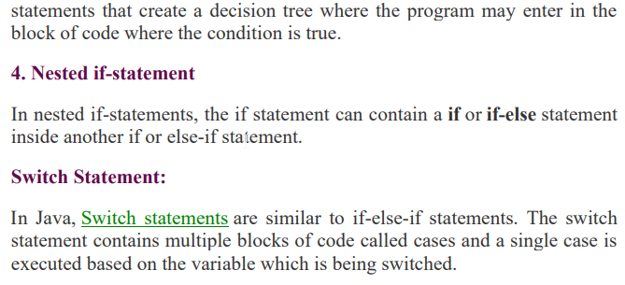

Slide 22
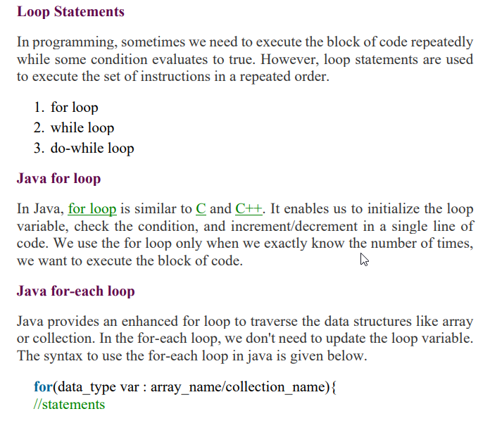

Slide 23

ForLoopExample
public class ForLoopExample {
public static void main(String[] args) {
for (int i = 1; i <= 5; i++) {
System.out.println(i);
}
}
}
for (int i = 1; i <= 5; i++): This is the for loop statement.
int i = 1: Initializes a variable i with the value 1. This is executed only once, before the loop starts.
i <= 5: This is the condition. The loop continues as long as i is less than or equal to 5.
i++: Increments the value of i by 1 after each iteration.
System.out.println(i);: This line prints the current value of i to the console.

Slide 24
DoWhile Example
public class DoWhileExample {
public static void main(String[] args) {
int i = 1;
do {
System.out.println(i);
i++;
} while (i <= 5);
}
}
Explanation:
The i variable is initialized to 1.
The do block starts, and the value of i is printed.
The value of i is incremented by 1.
The condition i <= 5 is checked. Since i is currently 2, the condition is true, and the loop repeats.
This process continues until i becomes 6.
When i is 6, the condition i <= 5 becomes false, and the loop ends.

Slide 25
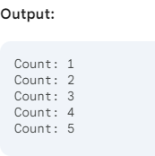
While Loop Example
public class WhileLoopExample {
public static void main(String[] args) {
int count = 1;
while (count <= 5) {
System.out.println("Count: " + count);
count++;
}
}
}
Explanation:
Initialization: An integer variable count is declared and initialized to 1.
Condition Check: The while loop checks if the value of count is less than or equal to 5. If true, the loop body executes.
Loop Body: The current value of count is printed to the console.
Increment: The value of count is increased by 1.
Iteration: The loop repeats from step 2 until the condition becomes false (i.e., count is greater than 5).

Slide 26
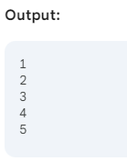
For Each Loop Example
public class ForEachLoopExample {
public static void main(String[] args) {
// Create an array of integers
int[] numbers = {1, 2, 3, 4, 5};
// Iterate over the array using for-each loop
for (int number : numbers) {
System.out.println(number);
}
}
}
Explanation:
Array creation: An integer array named numbers is created with values 1, 2, 3, 4, and 5.
For-each loop:
for (int number : numbers): This line declares a loop variable number of type int. The colon (:) indicates that number will take on the value of each element in the numbers array.
System.out.println(number): This line prints the current value of number to the console.

Slide 27
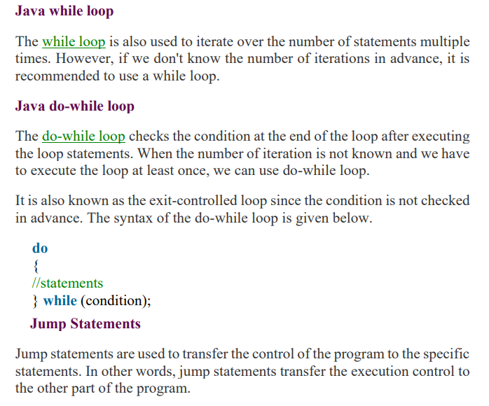

Slide 28
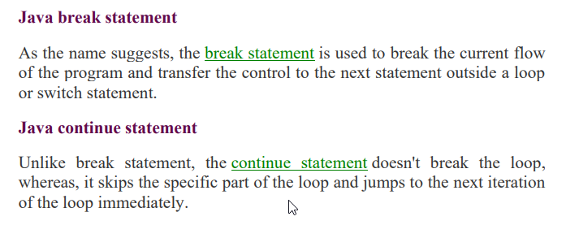

Slide 29
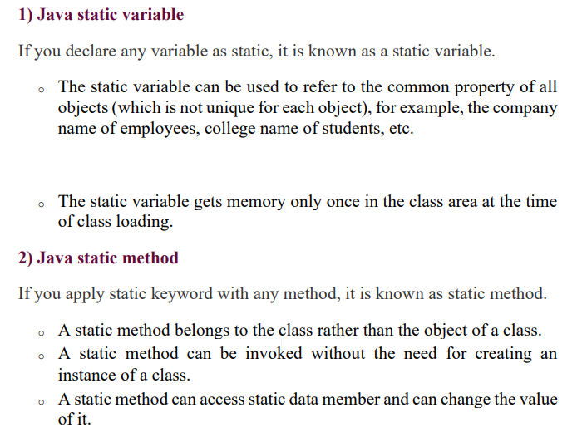

Slide 30
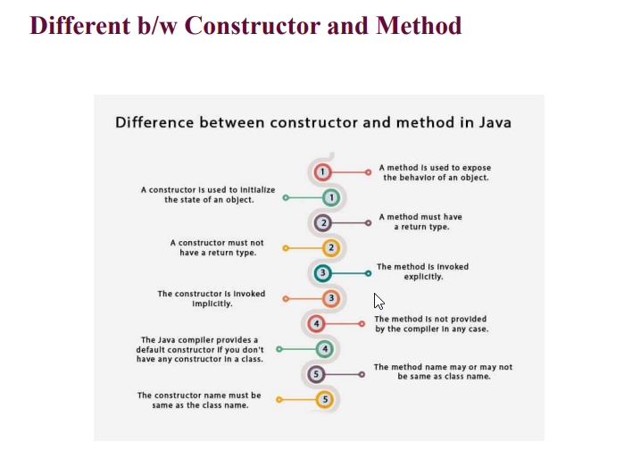

Slide 31
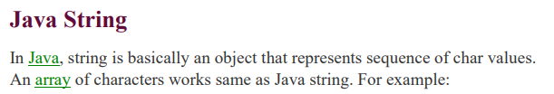
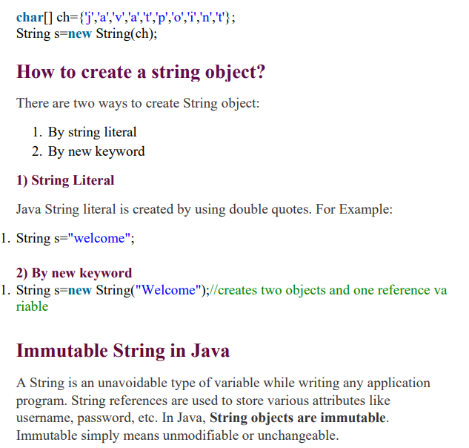

Slide 32
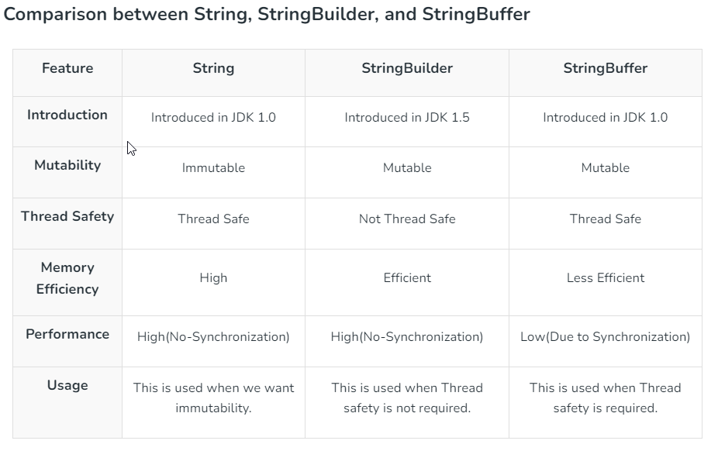
A string is a sequence of characters. In Java, objects of String are immutable which means a constant and cannot be changed once created. Initializing a String is one of the important pillars required as a pre-requisite with deeper understanding.

Slide 33
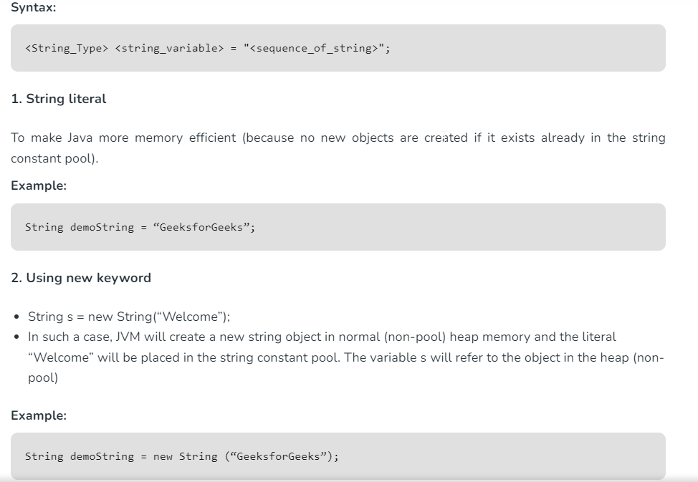
Ways of Creating a String
There are two ways to create a string in Java:
String Literal
Using new Keyword

Slide 34
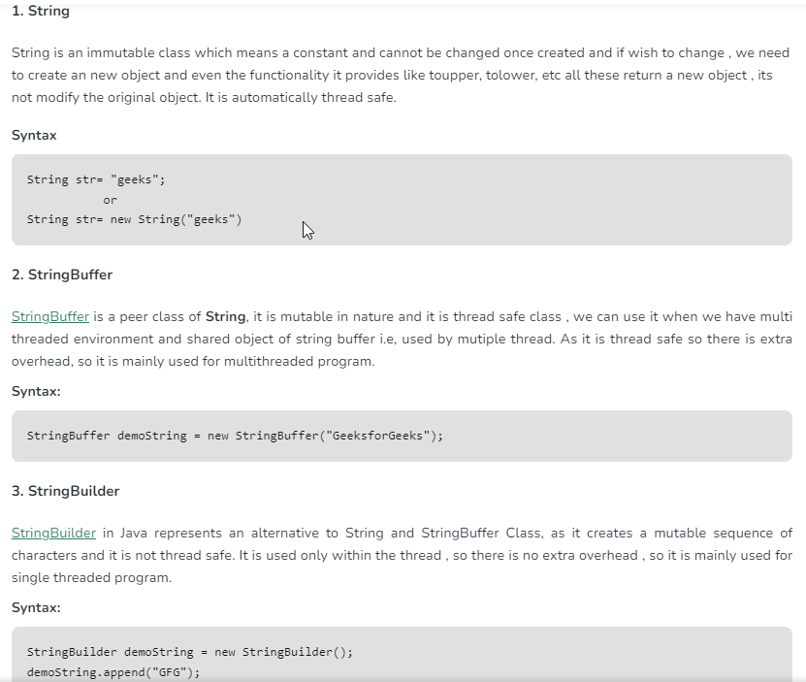

Slide 35
Immutable String in Java
In Java, string objects are immutable. Immutable simply means unmodifiable or unchangeable. Once a string object is created its data or state can’t be changed but a new string object is created.
// Java Program to demonstrate Immutable String in Java
import java.io.*;
class GFG {
public static void main(String[] args)
{
String s = "Sachin";
// concat() method appends
// the string at the end
s.concat(" Tendulkar");
// This will print Sachin
// because strings are
// immutable objects
System.out.println(s);
}
}
Output:
Sachin
Here Sachin is not changed but a new object is created with “Sachin Tendulkar”. That is why a string is known as immutable.
As you can see in the given figure that two objects are created but s reference variable still refers to “Sachin” and not to “Sachin Tendulkar”.
But if we explicitly assign it to the reference variable, it will refer to the “Sachin Tendulkar” object.

Slide 36
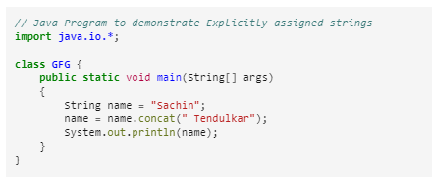


Slide 37
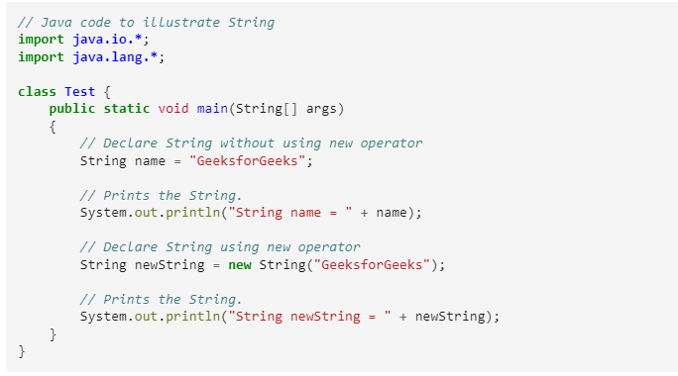
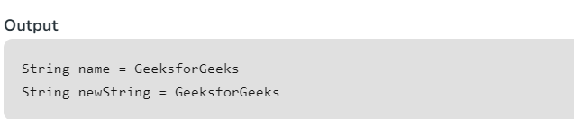

Slide 38
StringBuffer class in Java
StringBuffer is a class in Java that represents a mutable sequence of characters. It provides an alternative to the immutable String class, allowing you to modify the contents of a string without creating a new object every time.
Here are some important features and methods of the StringBuffer class:
StringBuffer objects are mutable, meaning that you can change the contents of the buffer without creating a new object.
The initial capacity of a StringBuffer can be specified when it is created, or it can be set later with the ensureCapacity() method.
The append() method is used to add characters, strings, or other objects to the end of the buffer.
The insert() method is used to insert characters, strings, or other objects at a specified position in the buffer.
The delete() method is used to remove characters from the buffer.
The reverse() method is used to reverse the order of the characters in the buffer.

Slide 39
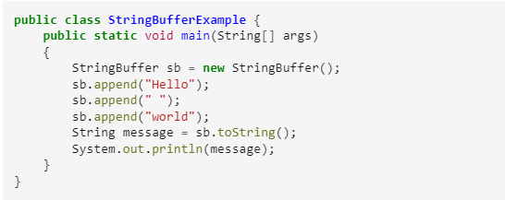
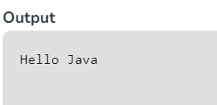
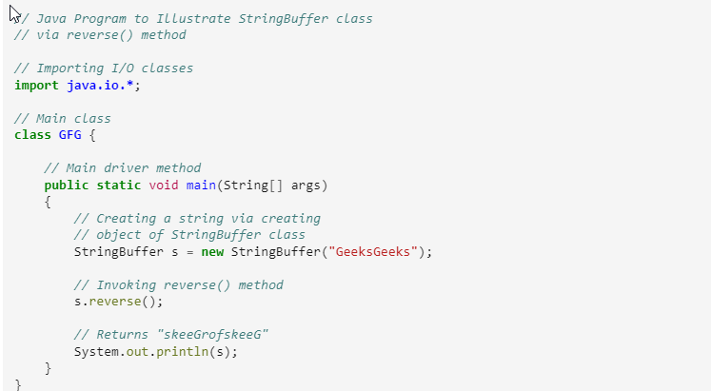


Slide 40
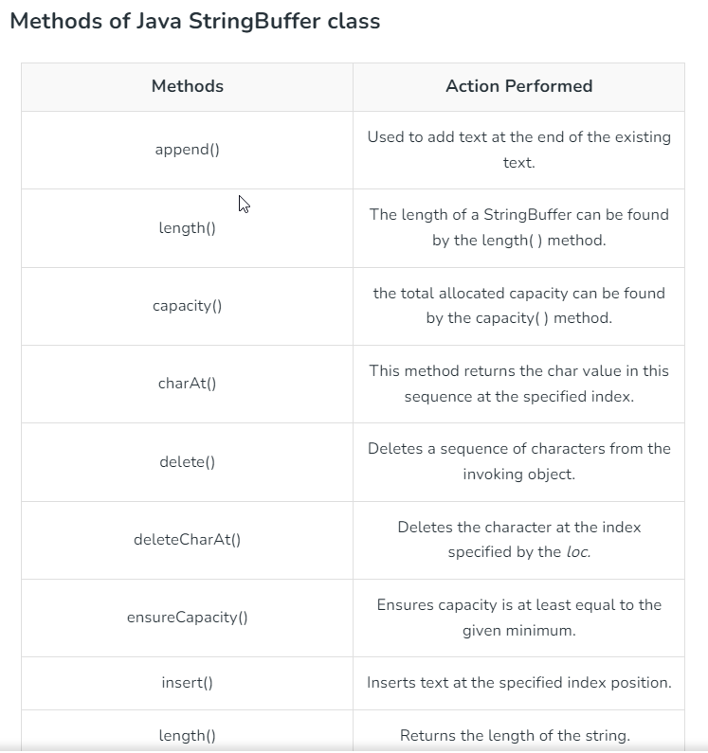

Slide 41
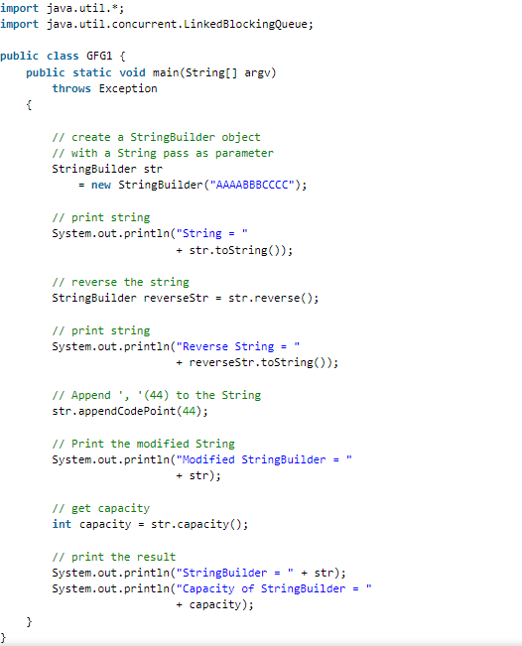
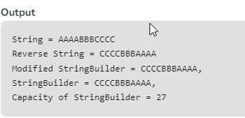

Slide 42
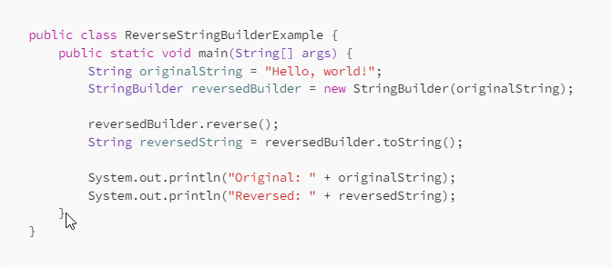
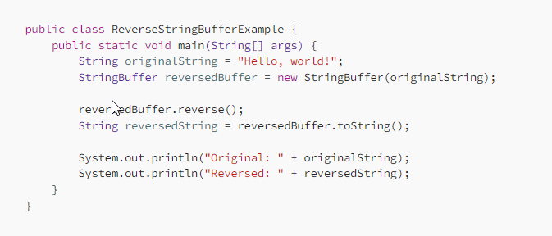

Slide 43
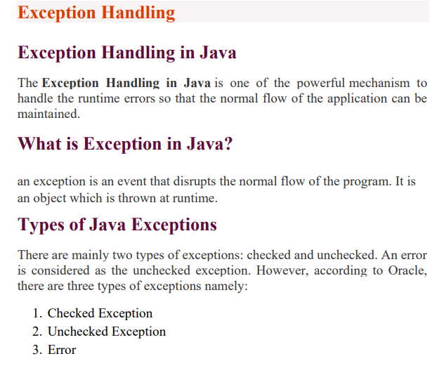

Slide 44
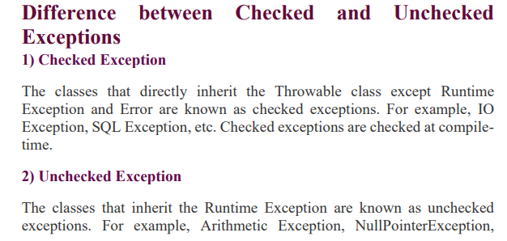
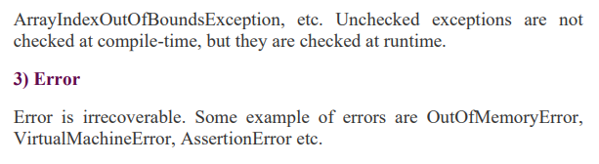

Slide 45
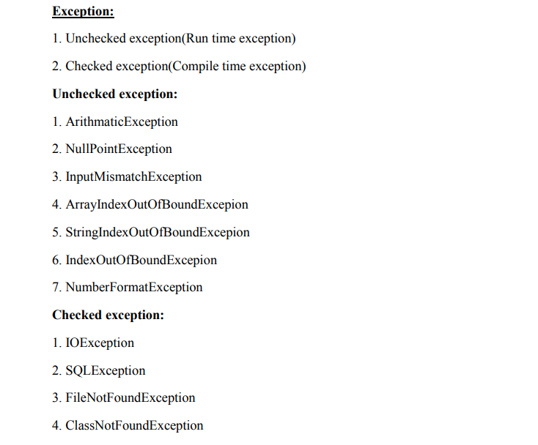

Slide 46
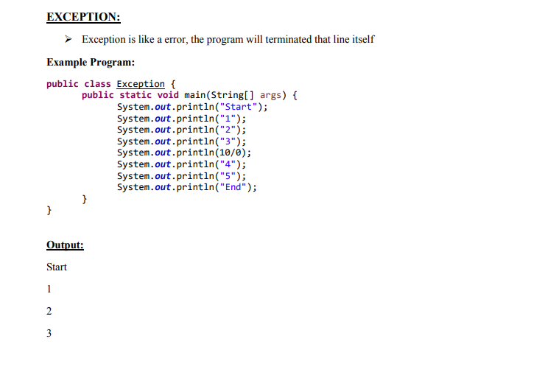


Slide 47

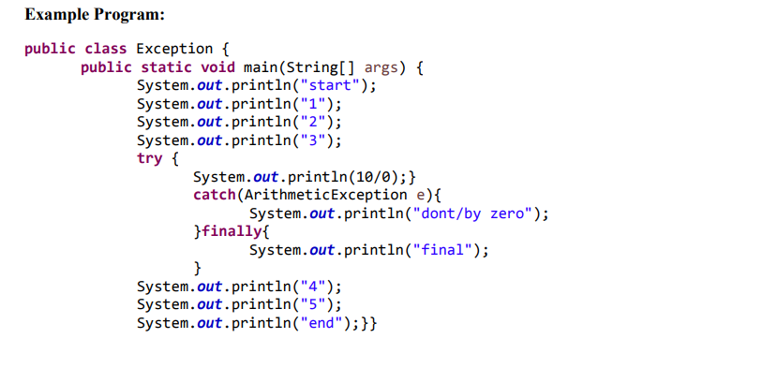


Slide 48


Slide 49



Slide 50


Slide 51


Slide 52


Slide 53


Slide 54



Slide 55


Slide 56



Slide 57



Slide 58



Slide 59



Slide 60


Slide 61


Slide 62
Java Collections:
In Java, collections are used to store and manipulate groups of objects. They provide a structured way to handle data, which is crucial for software testing.
1. List
Ordered collection of elements.
Allows duplicates.
Common implementations: ArrayList, LinkedList
2. Set
Unordered collection of unique elements.
Does not allow duplicates.
Common implementations: HashSet, TreeSet
3. Map
Stores key-value pairs.
Keys must be unique.
Common implementation: HashMap

Slide 63

Explanation:
A List of browser names is created using an ArrayList.
Elements are added to the list using the add method.
Elements can be accessed by their index (starting from 0).
A for-each loop is used to iterate over the elements.

Slide 64

Explanation:
An ArrayList of Strings is created named fruits.
Elements are added to the list using the add() method.
Elements can be accessed using their index (starting from 0). A for-each loop iterates over each element in the list.
The remove() method removes an element from the list.
The contains() method checks if an element exists in the list.

Slide 65

Explanation:
A LinkedList of Integers is created named numbers.
Elements are added to the list using the add() method.
Accessing elements by index is less efficient in LinkedList compared to ArrayList.
A for-each loop iterates over each element in the list.
The addFirst() method adds an element at the beginning of the list.
The removeLast() method removes the last element from the list.

Slide 66



Slide 67

Explanation:
A Set of operating system names is created using a HashSet.
Elements are added to the set using the add method.
Duplicates are automatically removed.
The contains method checks if an element exists in the set.

Slide 68


Slide 69
Explanation:
Import necessary classes: We import HashSet and Set from the java.util package.
Create a HashSet: We create a HashSet to store String elements.
Add elements: We use the add() method to add elements to the HashSet. Note that adding a duplicate element ("apple") is ignored.
Print the HashSet: We print the contents of the HashSet. The order of elements is not guaranteed because it's based on a hash table.
Check for element: We use the contains() method to check if "banana" is present in the HashSet.
Remove an element: We use the remove() method to remove "orange" from the HashSet.
Print the HashSet again: We print the updated HashSet.
Key Points
HashSet doesn't maintain any order of elements.
It doesn't allow duplicate elements.
It's efficient for searching, adding, and removing elements.
Common operations include add(), contains(), remove(), and iterating over elements using an iterator.

Slide 70

Explanation:
A Map to store user credentials is created using a HashMap.
Key-value pairs are added using the put method.
Values can be retrieved by their corresponding keys using the get method.

Slide 71

HashMap in Java: A Simple Example
A HashMap in Java is a data structure that stores key-value pairs. Each key is unique and maps to a corresponding value. It's based on a hash table, which provides efficient insertion, retrieval, and deletion of elements.

Slide 72
Explanation:
Import necessary classes: We import HashMap and Map from the java.util package.
Create a HashMap: We create a HashMap called studentAges to store student names (as keys) and their corresponding ages (as values).
Add elements: We use the put method to add key-value pairs to the HashMap.
Access values: We use the get method to retrieve the age of a student based on their name.
Check for key existence: We use the containsKey method to check if a particular key (student name) exists in the HashMap.
Iterate through the HashMap: We use an enhanced for loop to iterate through the HashMap and print each key-value pair.
Key Points
HashMaps are unordered collections.
Keys must be unique.
Values can be duplicates.
HashMaps are efficient for searching and retrieving elements.
The put method adds or replaces a key-value pair.
The get method retrieves the value associated with a key.
The containsKey method checks if a key exists.

Slide 73

Hash Table in Java: A Simple Example
Understanding Hash Tables
A hash table is a data structure that stores elements in key-value pairs. It uses a hash function to map keys to indices in an array. This allows for efficient insertion, deletion, and retrieval of elements.
Java's Hashtable Class
Java provides the Hashtable class to implement hash tables. However, it's generally recommended to use HashMap as it's not synchronized (and hence faster) in most cases. But for this example, we'll use Hashtable for simplicity.

Slide 74
Explanation:
Import: Imports the Hashtable class from the java.util package.
Create a Hashtable: Creates a Hashtable with String as keys and Integer as values.
Add Entries: Uses put method to add key-value pairs to the hash table.
Retrieve Value: Uses get method to retrieve the value associated with a key.
Check for Key: Uses containsKey method to check if a key exists.
Remove Entry: Uses remove method to remove a key-value pair.
Print Hashtable: Prints the entire hash table.
Key Points
Hash tables provide efficient lookup, insertion, and deletion operations.
Keys in a hash table must be unique.
The order of elements in a hash table is not guaranteed.
Hashtable is synchronized, which can impact performance in some cases.
Additional Notes
For better performance and flexibility, consider using HashMap instead of Hashtable in most cases.
You can iterate over the entries of a hash table using entrySet() and a for-each loop.
Hash tables are widely used in various applications, such as caching, indexing, and data structures.

